Slide 1
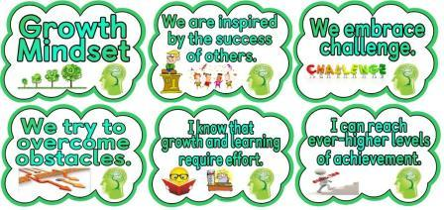
How do students experience a Growth Mindset curriculum?

Slide 2
Growth Mindset Theory
The belief intelligence is malleable and increasable.
A student can increase their intelligence through
Effort
Strategy
Persistence
Mastery-Orientation

Slide 4
Role of Failure
Failure is normal and necessary for mastery.
A Growth Mindset views failure as a challenge.
All successful people have failed at one point.

Slide 5
Purpose of the Study
Provide strategies for students to self-advocate for their learning
Normalize mistakes and failure
Create a culture of inquiry and challenge
Record students’ experiences with the Growth Mindset for teacher development

Slide 6
Benefits for your Child
Goal-setting
Learn how the brain learns
Experiment with multiple strategies
Self-motivation
Normalize failure and mistakes
Enjoy challenge through engaging activities

Slide 7
Steps of the Study
1. Study- initial questionnaire
2. Six-week Growth Mindset curriculum founded in research
3. Study- final questionnaire
4. Interview of focal participants

Slide 8
Reporting of the Study
Submit the thesis December 15, 2016
Hamline University’s Bush Library Digital Commons
Other possible publications and sharing

Slide 9
Confidentiality & Anonymity
No information about individual students or locations in any publication
No names
No genders
No school names
No city or department
Questionnaires and videotapes will be destroyed study- final.
Ms. Yamile will do the questionnaires and assign participants a number that I will not know.

Slide 10
Informed Consent
Participation is voluntary
Three options:
General participant
Focal participant
Not participate
You may decide to withdraw at any time without negative consequences.
Sign an Informed Consent form

Slide 11
When we own the story, we can write a brave new ending.
-Brene Brown, 2015

Slide 12
Questions?

